Slide 1
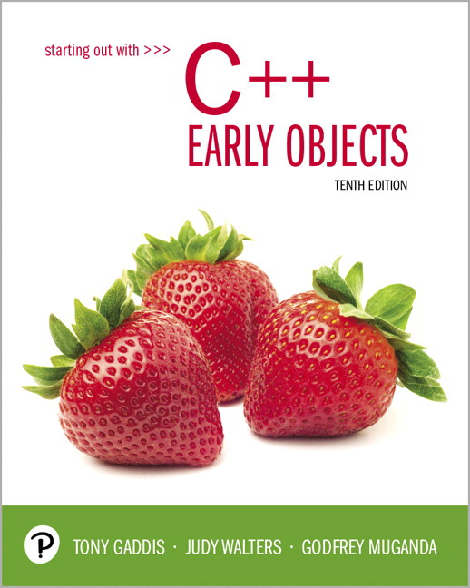
Starting Out with C++ Early Objects
Tenth Edition
Chapter 2
Introduction to C++

Slide 2
Topics 1of 2
2.1 The Parts of a C++ Program
2.2 The cout Object
2.3 The #include Directive
2.4 Variables and the Assignment Statement
2.5 Literals
2.6 Identifiers
2.7 Integer Data Types
2.8 Floating-Point Data Types
2.9 The char Data Type

Slide 3
Topics 2 of 2
2.10 The C++ string Class
2.11 The bool Data Type
2.12 Determining the Size of a Data Type
2.13 More on Variable Assignments and Initialization
2.14 Scope
2.15 Arithmetic Operators
2.16 Comments
2.17 Programming Style

Slide 4
2.1 The Parts of a C++ Program 1 of 2
// sample C++ program
#include <iostream>
using namespace std;
int main()
{
cout << "Hello, there!";
return 0;
}
comment
preprocessor directive
which namespace to use
beginning of function named main
beginning of block for main
output statement
send 0 back to operating system
end of block for main

Slide 5
2.1 The Parts of a C++ Program 2 of 2
Statement | Purpose
// sample C++ program | comment
#include <iostream> | preprocessor directive
using namespace std; | which namespace (set of names) to use
int main() | beginning of function named main
{ | beginning of block for main
cout << "Hello, there!"; | output statement
return 0; | send 0 back to the operating system
} | end of block for main

Slide 6
Special Characters
Character | Name | Description
// | Double Slash | Begins a comment
# | Pound Sign | Begins preprocessor directive
< > | Open, Close Brackets | Encloses filename used in #include directive
( ) | Open, Close Parentheses | Used when naming a function
{ } | Open, Close Braces | Encloses a group of statements
" " | Open, Close Double Quote Marks | Encloses a string of characters
; | Semicolon | Ends a programming statement
Notes:
See pr2-01.cpp

Slide 7
Important Details
C++ is case-sensitive. Uppercase and lowercase characters are different characters. ‘Main’ is not the same as ‘main’.
Every { must have a corresponding }, and vice-versa.

Slide 8
2.2 The cout Object
Displays information on computer screen
Use << to send information to cout
cout << "Hello, there!";
You can use << to send multiple items to cout
cout << "Hello, " << "there!";
Or
cout << "Hello, ";
cout << "there!";
Notes:
See pr2-02.cpp and pr 2-03.cpp

Slide 9
Starting a New Line
To get multiple lines of output on screen
- Use endl
cout << "Hello, there!" << endl;
Use \n in an output string
cout << "Hello, there!\n";
Notes:
See pr2-04.cpp, pr2-05.cpp, and pr2-06.cpp

Slide 10
Escape Sequences – More Control Over Output
Escape Sequence | Name | Description
\n | Newline | Causes the cursor to go to the next line for subsequent printing
\t | Horizontal tab | Causes the cursor to skip over to the next tab stop
\a | Alarm | Causes the computer to beep
\b | Backspace | Causes the cursor to back up (i.e., move left) one position
\r | Return | Causes the computer to go to the beginning of the current line, not the next line
\\ | Backslash | Causes a backslash to be printed
\' | Single quote | Causes a single quotation mark to be printed
\" | Double quote | Causes a double quotation mark to be printed

Slide 11
Common Escape Sequence Mistakes
Don’t confuse "\" (a back slash) and "/" (a forward slash)
Remember to put \n in double quotation marks

Slide 12
2.3 The #include Directive
Inserts the contents of another file into the program
It is a preprocessor directive
Not part of the C++ language
Not seen by compiler
Example:
#include <iostream>
No ; goes
here

Slide 13
2.4 Variables and the Assignment Statement 1 of 2
A Variable
Is used to refer to a location in memory where a value can be stored.
An assignment statement is used to store a value.
The value that is stored can be changed, i.e., it can “vary”.
You must define the variable (indicate the name and the type of value that it can hold) before you can use it to store a value.

Slide 14
Variables
If a new value is stored in the variable, it replaces the previous value
The previous value is overwritten and can no longer be retrieved
int age;
age = 17; // Assigns 17 to age
cout << age; // Displays 17
age = 18; // Now age is 18
cout << age; // Displays 18
Notes:
See pr2-07.cpp

Slide 15
Assignment Statement
Uses the = operator
Has a single variable on the left side and a value on the right side
Copies the value on the right into the location in memory that is associated with the variable on the left
item = 12;

Slide 16
2.5 Literals
A Literal is a piece of data that is written directly in the source code of the program.
'A' // character literal
"Hello" // string literal
12 // integer literal
"12" // string literal (yes!)
3.14 // floating-point literal
Notes:
See pr2-08.cpp

Slide 17
2.6 Identifiers
Programmer-chosen names to represent parts of the program, such as variables
Name should indicate the use of the identifier
Cannot use C++ key words as identifiers
Must begin with alphabetic character or _, followed by any number of alphabetic, numeric, or _ characters.
Alphabetic characters may be upper- or lowercase

Slide 18
Multi-word Variable Names
A variable name should reflect its purpose
Descriptive variable names may include multiple words
Two conventions to use in naming variables:
Capitalize all words but the first letter of first word. Run words together:
quantityOnOrder totalSales
Use the underscore _ character as a word separator:
quantity_on_order total_sales
Use one convention consistently throughout a program

Slide 19
Valid and Invalid Identifiers
IDENTIFIER | VALID? | REASON IF INVALID
totalSales | Yes | blank
total_sales | Yes | blank
total.Sales | No | Cannot contain period
4thQtrSales | No | Cannot begin with digit
total$Sales | No | Cannot contain $

Slide 20
2.7 Integer Data Types
Designed to hold whole (non-decimal) numbers
Can be signed or unsigned
12 -6 +3
Available in different sizes (i.e., number of bytes): short int, int, long int, and long long int
long long int was introduced in C++ 11.

Slide 21
Signed vs. Unsigned Integers
C++ allocates one bit for the sign of the number. The rest of the bits are for data.
If a variable in a program will not hold negative values, you can declare the variable to be unsigned. All of the bits in unsigned numbers are used for data.
A variable is signed unless the unsigned keyword is used at variable definition.

Slide 22
Defining Variables
Variables of the same type can be defined
- In separate statements
int length;
int width;
- In the same statement
int length,
width;
Variables of different types must be defined in separate statements
Notes:
See pr2-09.cpp and pr2-10.cpp

Slide 23
Abbreviated Variable Definitions
int can be omitted from a variable definition for any datatype except an int itself.
Examples:
short temperatures;
unsigned short booksOnOrder;
unsigned long long magnitude;
int grades;
Notes:
See pr2-09.cpp and pr2-10.cpp

Slide 24
Integral Literals
To store an integer literal in a long memory location, put ‘L’ at the end of the number: long rooms = 234L;
Use ‘LL’ at the end to put an integer literal in a long long memory location.
Literals that begin with ‘0’ (zero) are octal, or base 8: 075
Literals that begin with ‘0x’ are hexadecimal, or base 16: 0x75A

Slide 25
2.8 Floating-Point Data Types
Designed to hold real numbers
12.45 -3.8
Stored in a form similar to scientific notation
Numbers are all signed
Available in different sizes (number of bytes): float, double, and long double
Size of float ≤ size of double
≤ size of long double
Notes:
See pr2-11.cpp

Slide 26
Floating-point Literals
Can be represented in
Fixed point (decimal) notation:
31.4159 0.0000625
E notation:
3.14159E1 6.25e-5
Are double by default
Can be forced to be float 3.14159F or long double 0.0000625L

Slide 27
Assigning Floating-point Values to Integer Variables
If a floating-point value (a literal or a variable) is assigned to an integer variable
The fractional part will be truncated (i.e., “chopped off” and discarded)
The value is not rounded
int rainfall = 3.88;
cout << rainfall; // Displays 3

Slide 28
2.9 The char Data Type
Used to hold single characters or very small integer values
Usually occupies 1 byte of memory
A numeric code representing the character is stored in memory
SOURCE CODE | MEMORY
char letter = 'C'; | variable letter holds the integer value 67
Notes:
See pr2-12.cpp and pr2-13.cpp

Slide 29
Character Literal
A character literal is a single character
When referenced in a program, it is enclosed in single quotation marks:
cout << 'Y' << endl;
The quotation marks are not part of the literal, and are not displayed

Slide 30
String Literals
Can be stored as a series of characters in consecutive memory locations
"Hello"
Stored in consecutive memory locations with the null terminator, \0, automatically placed at the end:
Is comprised of the characters between the " "
H | e | l | l | o | \0

Slide 31
A character or a string literal?
A character literal is a single character, enclosed in single quotes:
'C'
A string literal is a sequence of characters enclosed in double quotes:
"Hello, there!"
A single character in double quotes is a string literal, not a character literal:
"C"
Notes:
See pr2-14.cpp

Slide 32
2.10 The C++ string Class
Must #include <string> to create and use string objects
Can define string variables in programs
string name;
Can assign values to string variables with the assignment operator
name = "George";
Can display them with cout
cout << "My name is " << name;
Notes:
See pr2-15.cpp

Slide 33
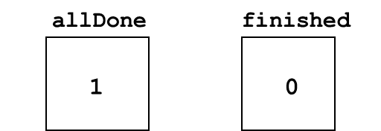
2.11 The bool Data Type
Represents values that are true or false
bool values are stored as integers
false is represented by 0, true by 1
bool allDone = true;
bool finished = false;
Notes:
See pr2-16.cpp

Slide 34
2.12 Determining the Size of a Data Type
The sizeof operator gives the size in number of bytes of any data type or variable
double amount;
cout << "A float is stored in "
<< sizeof(float) << " bytes\n";
cout << "Variable amount is stored in "
<< sizeof(amount) << " bytes\n";
Notes:
See pr2-17.cpp

Slide 35
2.13 More on Variable Assignments and Initialization
Assigning a value to a variable
Assigns a value to a previously created variable
A single variable name must appear on left side of the = symbol
int size;
size = 5+2; // legal
5 = size; // not legal

Slide 36
Variable Assignment vs. Initialization
Initializing a variable
Gives an initial value to a variable at the time it is defined
Some or all of the variables being defined can be initialized
int length = 12;
int width = 7, height = 5, area;
Notes:
See pr2-18.cpp

Slide 37
Using auto in Variable Declarations
If you are initializing a variable when it is defined, the auto keyword will determine the data type to use based on the type of the initialization value. Introduced in C++ 11.
auto length = 12; // length is an int
auto width = length; // also an int
auto area = 100.0; // area is a double
Notes:
See pr2-18.cpp

Slide 38
2.14 Scope
The scope of a variable is that part of the program where the variable may be used
A variable cannot be used before it is defined
int num1 = 5;
cout << num1; // legal
cout << num2; // illegal
int num2 = 12;
Notes:
See pr2-19.cpp

Slide 39
2.15 Arithmetic Operators
Used for performing numeric calculations
C++ has unary, binary, and ternary operators
unary (1 operand) -5
binary (2 operands) 13 - 7
ternary (3 operands) exp1 ? exp2 : exp3

Slide 40
Binary Arithmetic Operators
SYMBOL | OPERATION | EXAMPLE | ans
+ | addition | ans = 7 + 3; | 10
- | subtraction | ans = 7 - 3; | 4
* | multiplication | ans = 7 * 3; | 21
/ | division | ans = 7 / 3; | 2
% | modulus | ans = 7 % 3; | 1
Notes:
See pr2-20.cpp

Slide 41
/ Operator
C++ division operator (/)performs integer division if both operands are integers
cout << 13 / 5; // displays 2
cout << 2 / 4; // displays 0
If either operand is floating-point, the result is floating-point
cout << 13 / 5.0; // displays 2.6
cout << 2.0 / 4; // displays 0.5

Slide 42
% Operator
C++ modulus operator (%) computes the remainder resulting from integer division
cout << 9 % 2; // displays 1
% requires integers for both operands
cout << 9 % 2.0; // error
Notes:
See pr2-21.cpp

Slide 43
2.16 Comments
Are used to document parts of a program
Are written for persons reading the source code of the program
Indicate the purpose of the program
Describe the use of variables
Explain complex sections of code
Are ignored by the compiler

Slide 44
Single-Line Comments
Begin with // and continue to the end of the line
int length = 12; // length in inches
int width = 15; // width in inches
int area; // calculated area
// Calculate rectangle area
area = length * width;
Notes:
See pr2-22.cpp

Slide 45
Multi-Line Comments
Begin with /* and end with */
Can span multiple lines
/*----------------------------
Here's a multi-line comment
that has two lines of text
----------------------------*/
Can also be used as single-line comments
int area; /* Calculated area */

Slide 46
2.17 Programming Style
Refers to the visual arrangement of the source code
Provides information to the reader about the organization of the program
Includes alignment of matching { and } and the use of indentation and whitespace.
Should be used consistently throughout a program

Slide 47

Copyright

